Slide 1





Film Festival Revamp
Joshua Williams and Bder Khan

Slide 2

Introduction
UCCS shall benefit from a restructured Film Festival that shows movies that are more diverse.
World is growing, people are meeting all kinds of people.
Most small movies and big movies are not diverse.
More diverse directors, actors, and movies are emerging to the scene.
Create an environment in which creators of all sorts can emerge from.
A film festival with a bigger audience and bigger creator selection.

Slide 3
Background
Movies from people from all parts of the planet are gaining much needed traction.
Movies like ‘Get Out’, ‘Us’, and ‘Spider-Man: Into the Spider-Verse’ with diverse creators and actors.
These are some of the most popular films to come out in the past couple of years.
Yet the majority of popular films are not diverse at all.

Slide 4
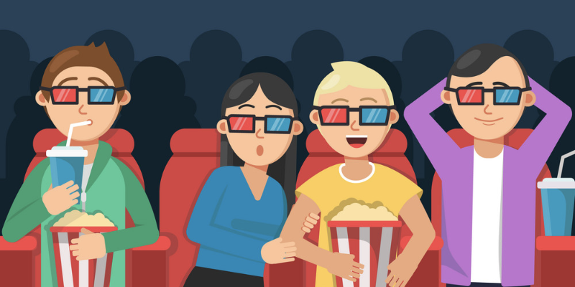
Technical Background
People aren’t going out to watch movies as modern technology allows you to watch them at home.
We need to showcase the latest trends in diversity and the experience of going to the theaters to watch movies.
Experimental movie watching experiences.
  Two sections:
    Movie will be played uninterrupted.
    Watch the movie chapter by chapter.

Slide 5
Requirements and Criteria
Film makes of Diverse Backgrounds
Films with diverse casts from the last 3 years
Film Student Volunteers
Submission from independent Colorado film makers of diverse backgrounds

Slide 6
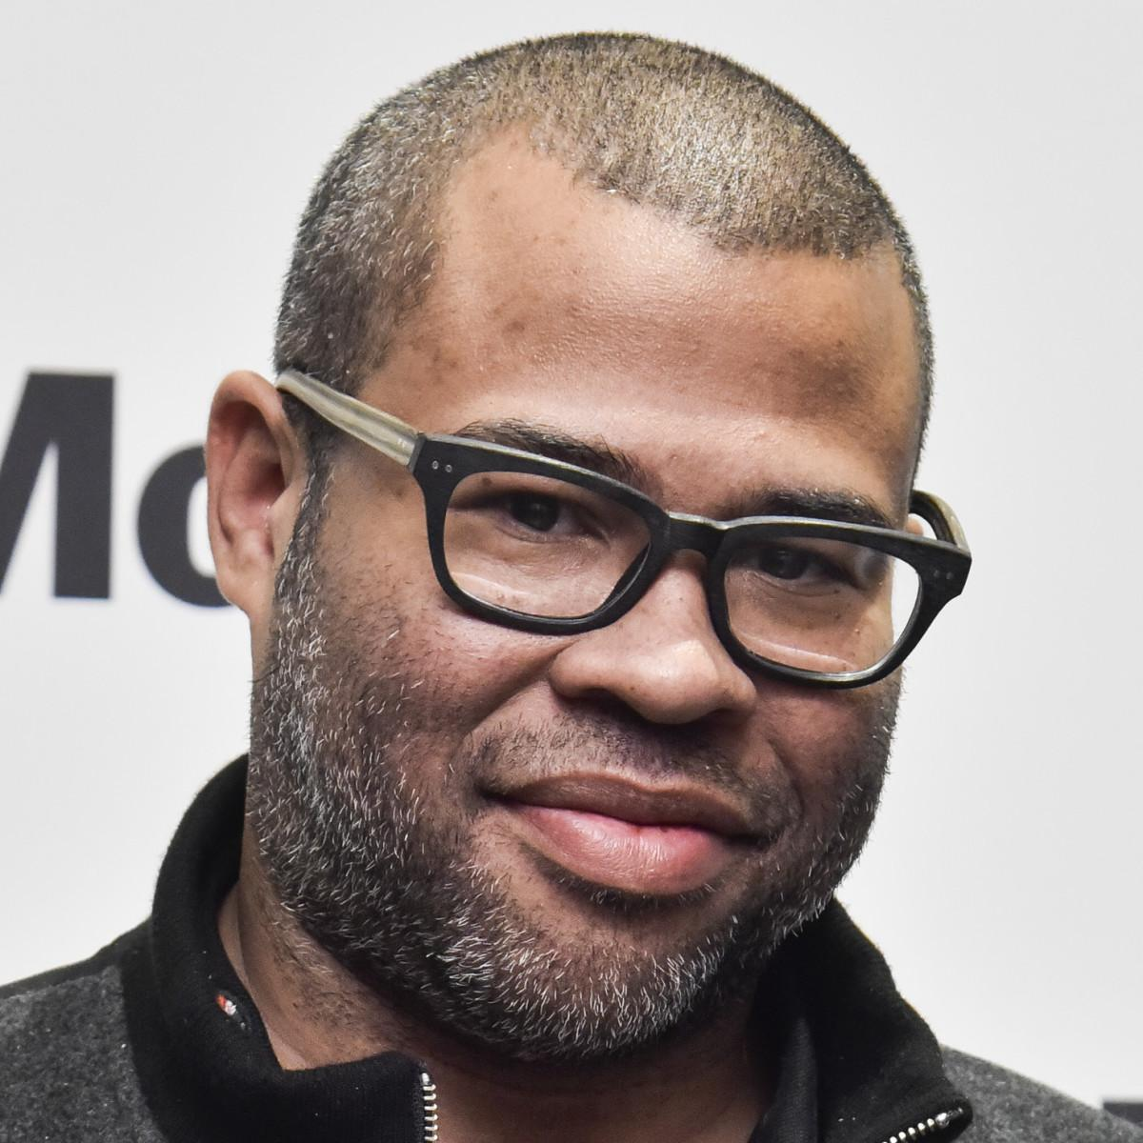
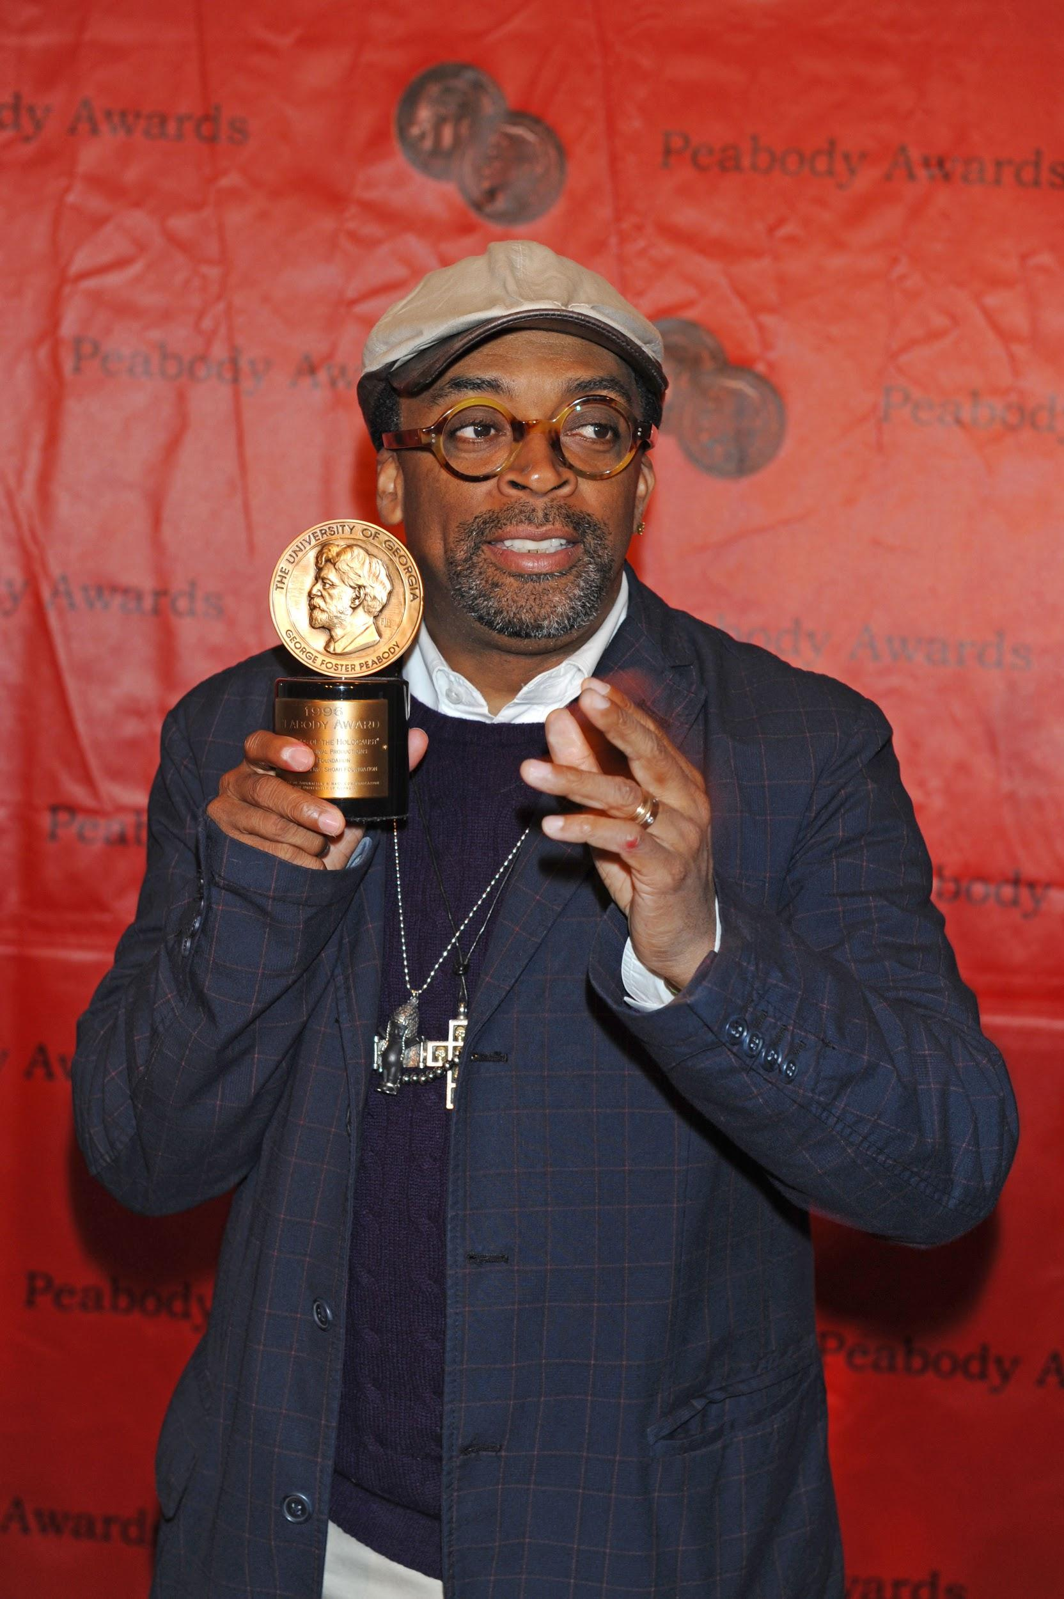
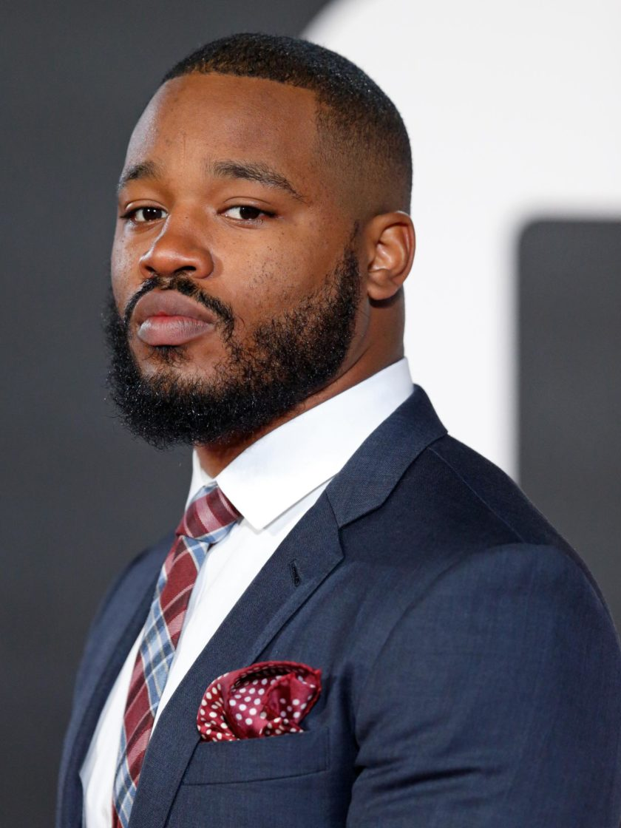
Requirement and Criteria: Directors
Jordan Peele
Spike Lee
Ryan Coogler

Slide 7


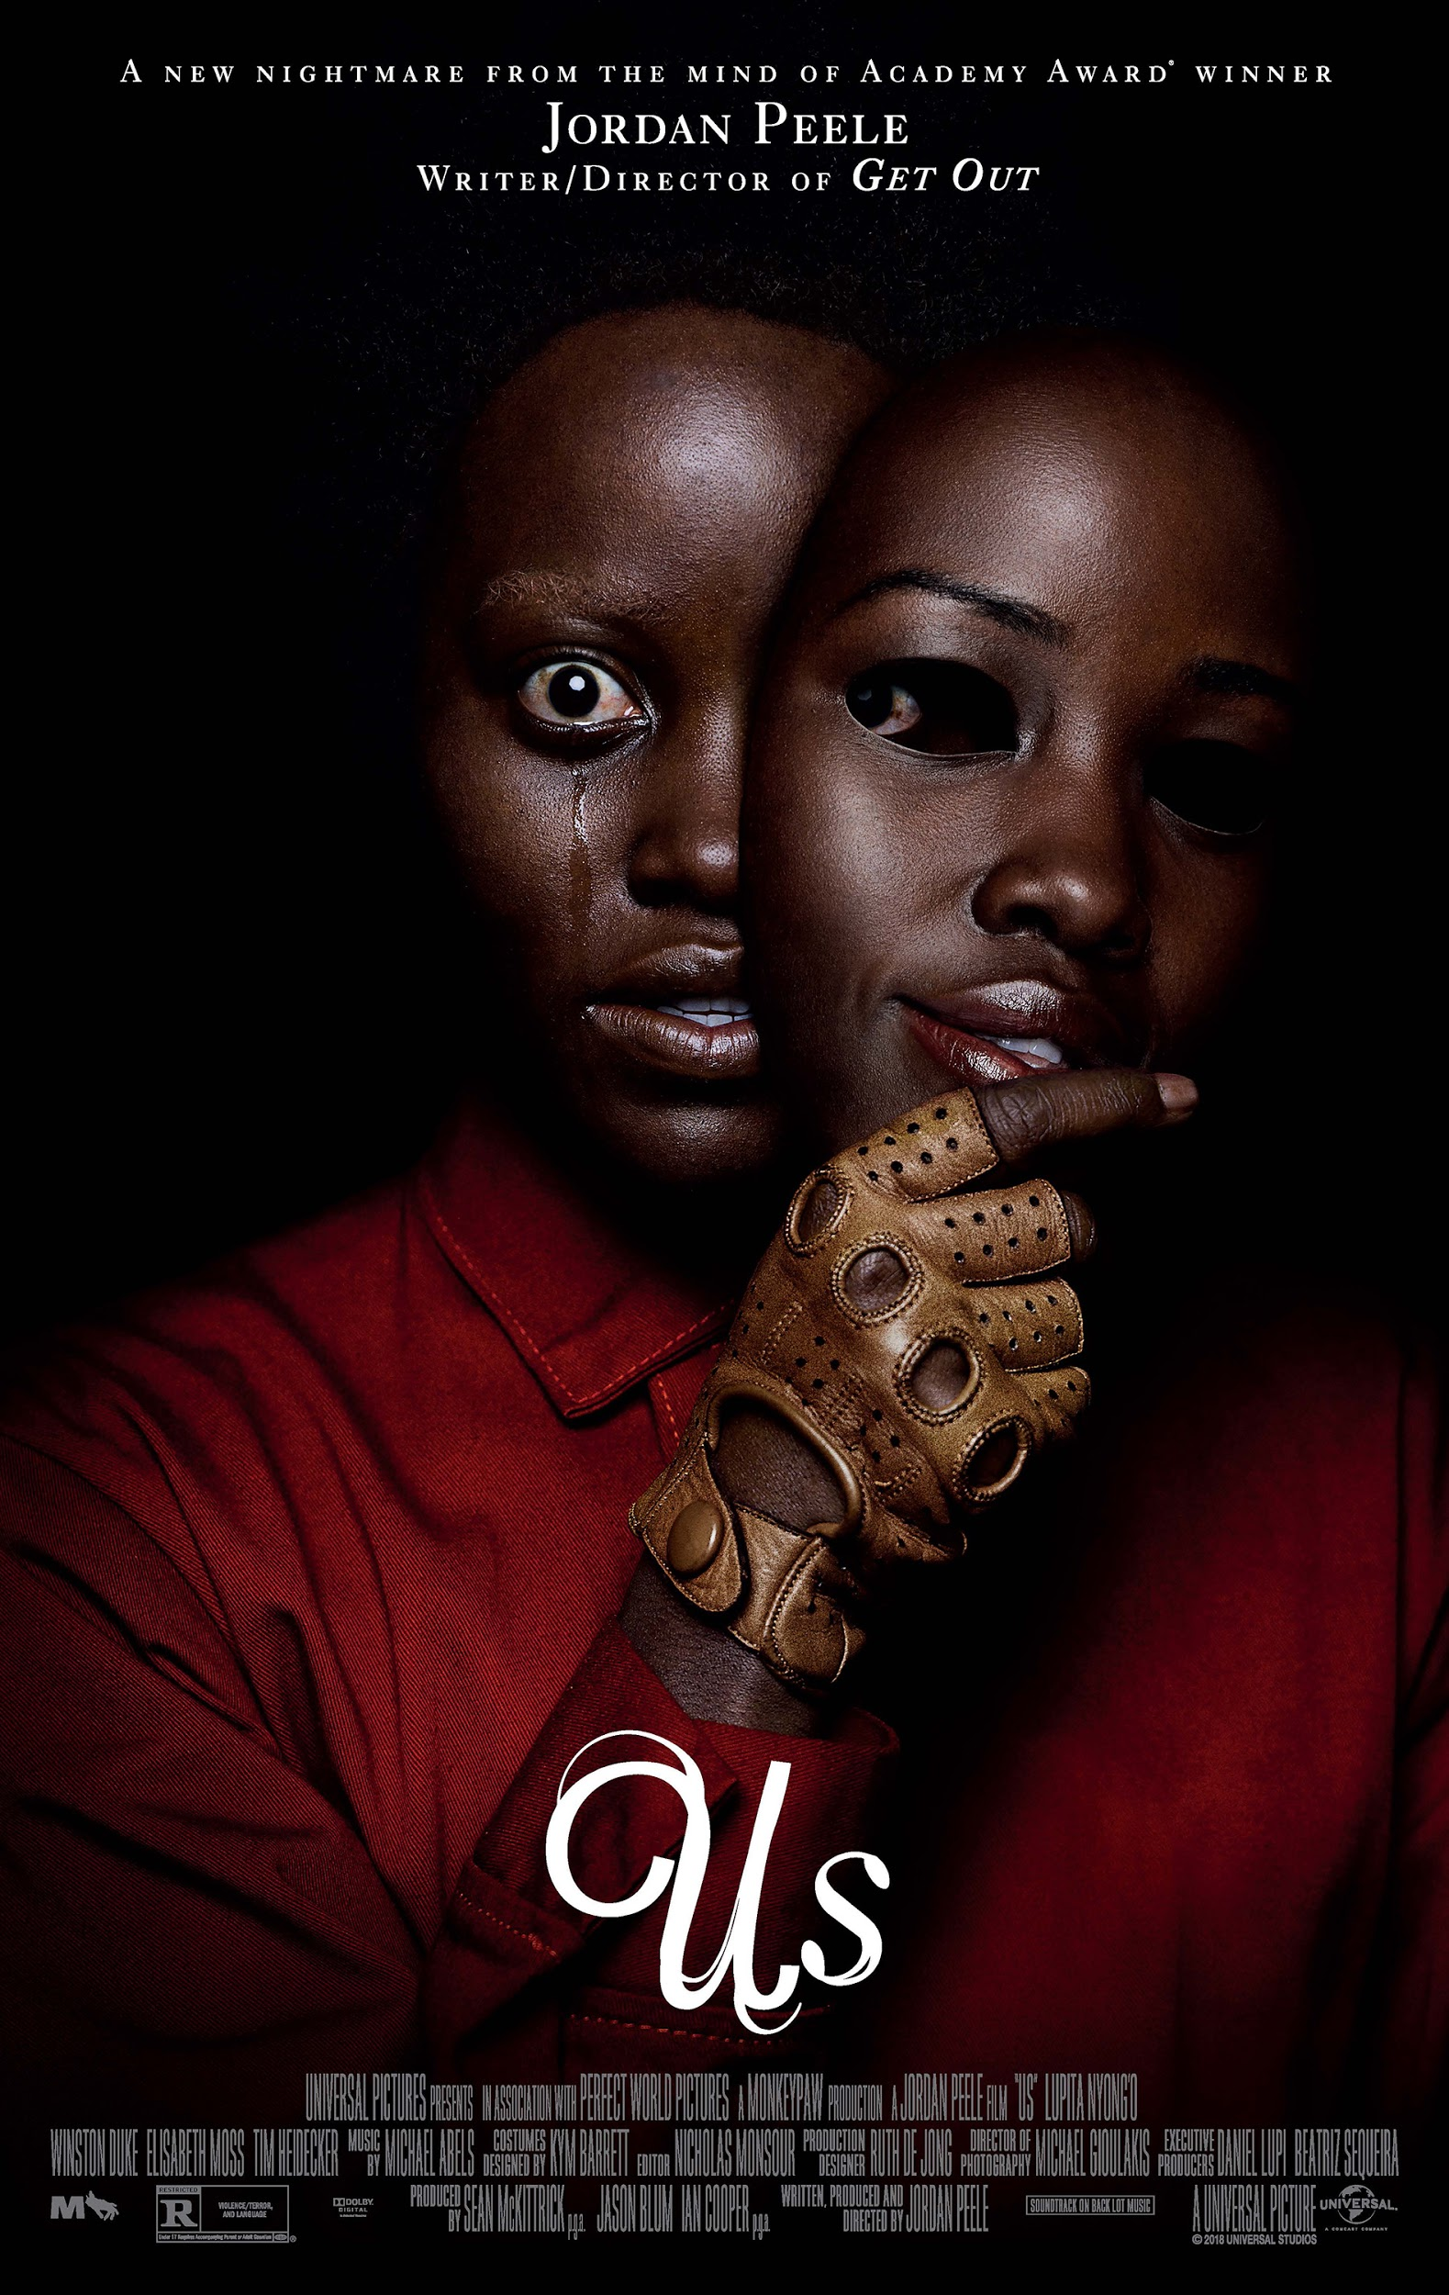

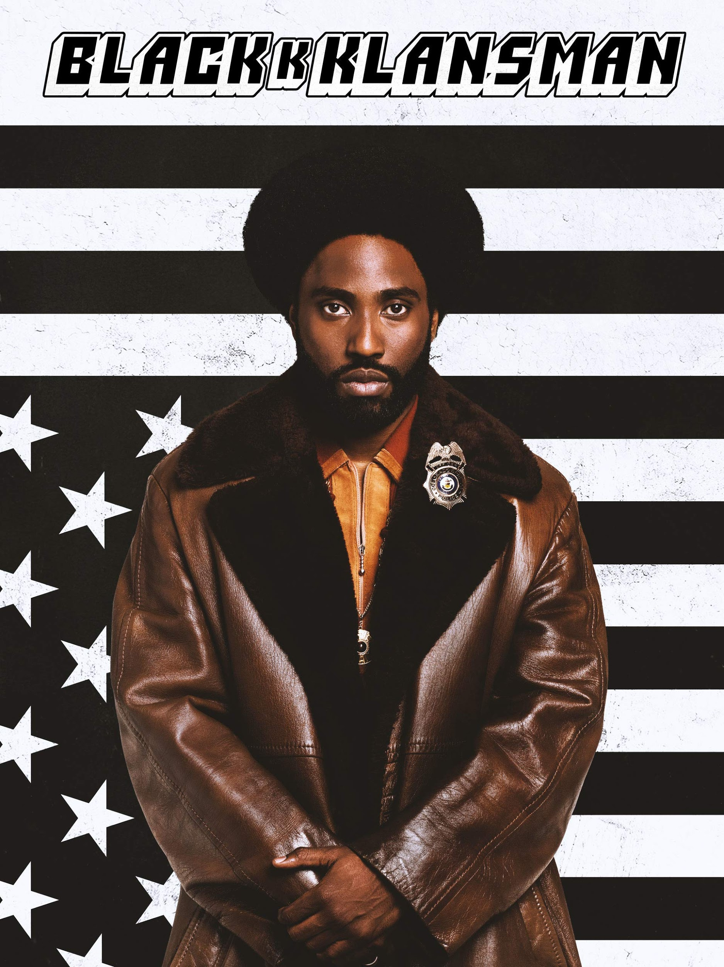
Requirements and Criteria: Films

Slide 8
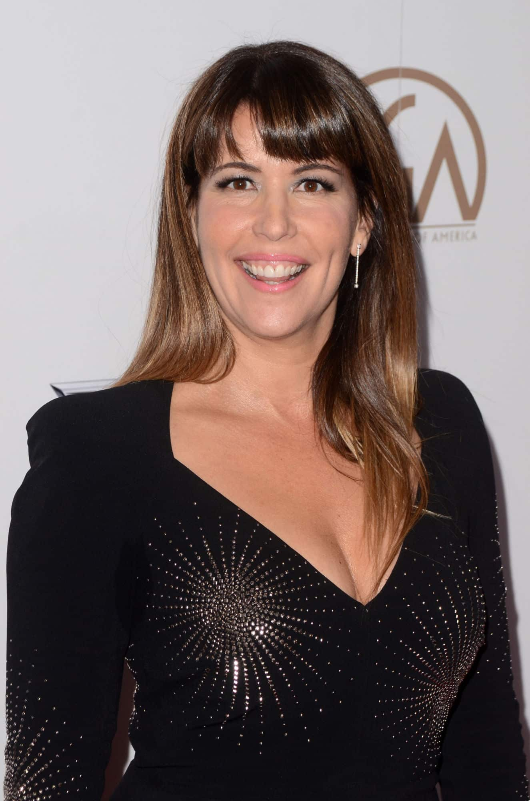

Female Director
There needs to be more female representations for films.
Live action movie ‘Wonder Woman’
Patty Jenkins - Director of ‘Wonder Woman’

Slide 9
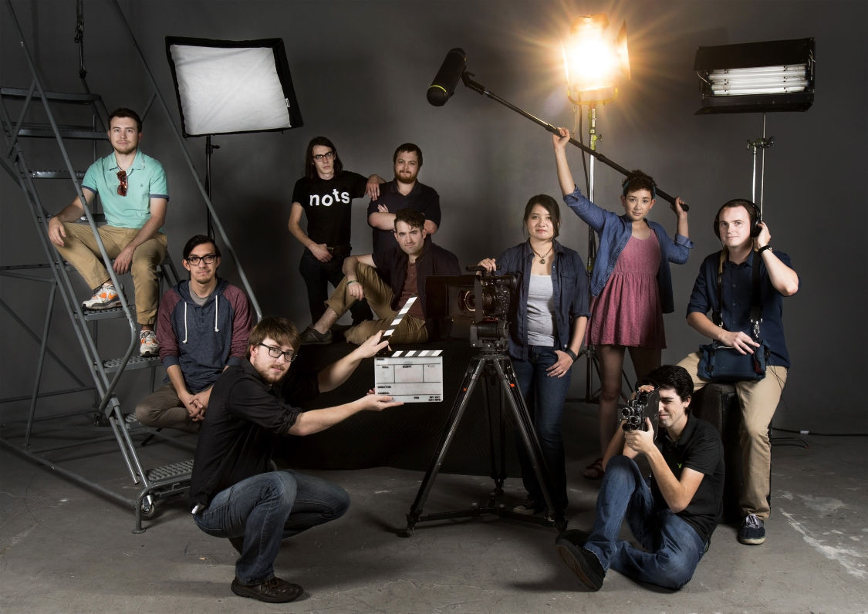
Student Filmmakers

Slide 10
Finale Conclusion and Recommendation
A worthwhile endeavor for UCCS.
Bringing attention to the school with high status events.
Encouraging more types of people to get interested in the film industry.
Possible influence of the next up and coming movie star and director.

